Slide 1
Social Data Mining Techniques
GROUP - 7
Final Project
Video Link: https://www.youtube.com/watch?v=JZJY16NojUc

Slide 2

Overview
This Project deals with the web scraping of reviews of the movie series, Pirates of the Caribbean from the IMDB website using Selenium. Later used Text blob and NLTK to perform Sentiment Analysis to calculate the Polarity of the reviews and categorize the reviews into positive, negative and neutral Polarity, and and stored it in MongoDB cluster. Finally, the sentiments of the reviews are displayed di using Power BI dashboard.

Slide 3
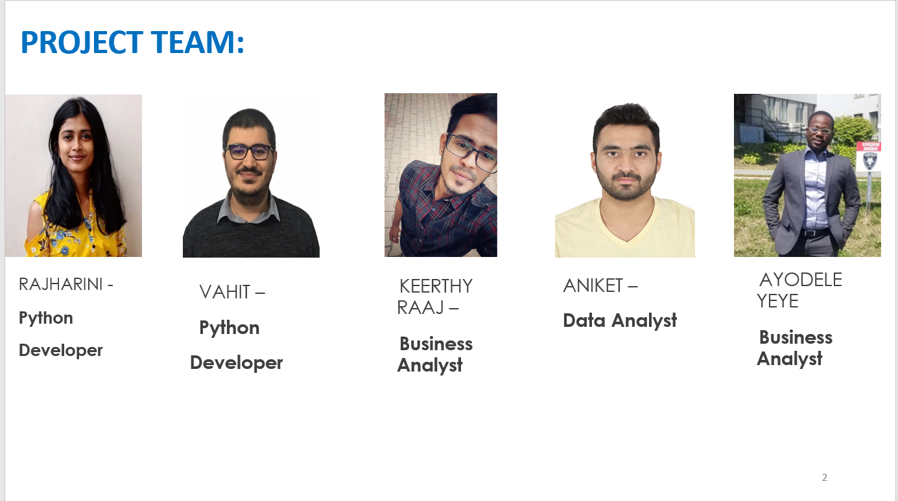

Slide 4

Languages Used
PYTHON
Tools Used
JUPYTER NOTEBOOK
VS CODE
MONGODB ATLAS
BROWSER
POWER BI

Slide 5
LIBRARIES Used
1.Selenium
3.PyMongo
2.Pandas
4.TextBlob
5.NLTK

Slide 6



Architecture DIAGRAM
Selenium
Sentiment Analysis
List of Data
Text Blob
Dataset
WEB SCRAPING
CSV
DATA ANALYSIS

Slide 7
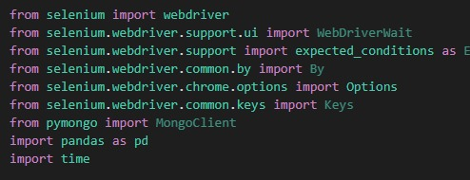
Web Scrapping Code

Slide 8
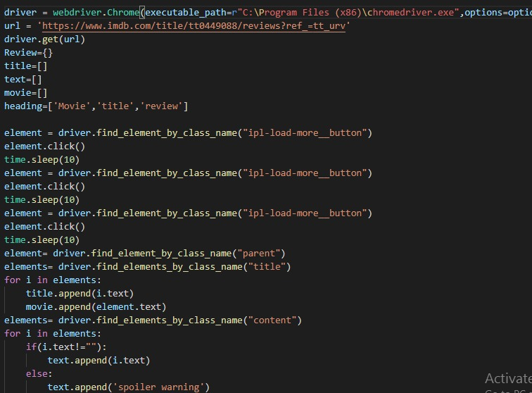

Slide 9
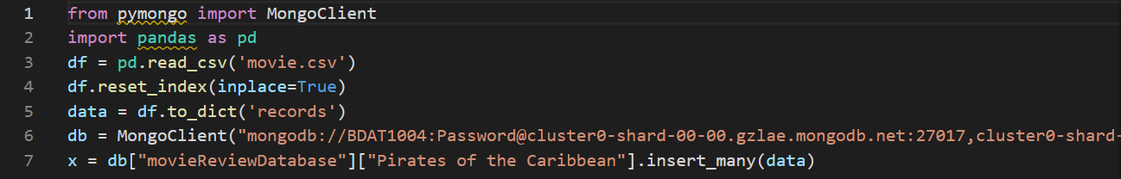
MongoDB Code

Slide 10
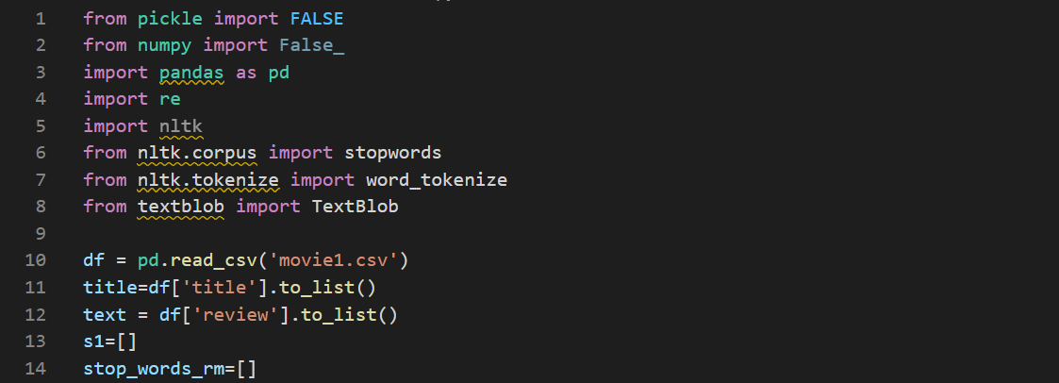
Sentiment Analysis Code

Slide 11
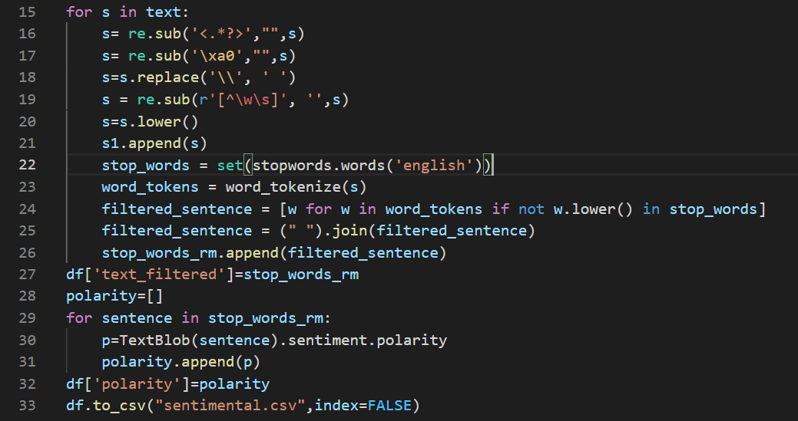

Slide 12
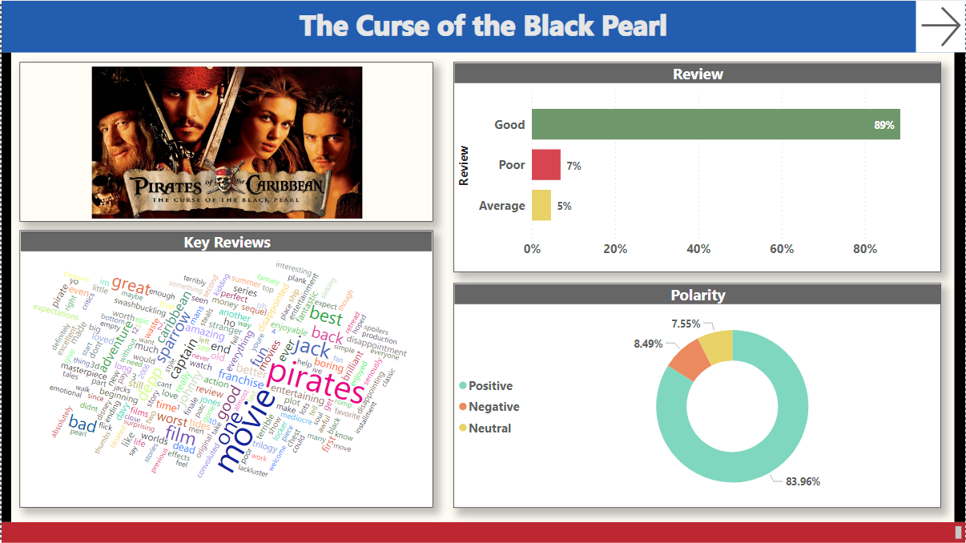
Dashboard 1 – The Curse of the Black Pearl

Slide 13
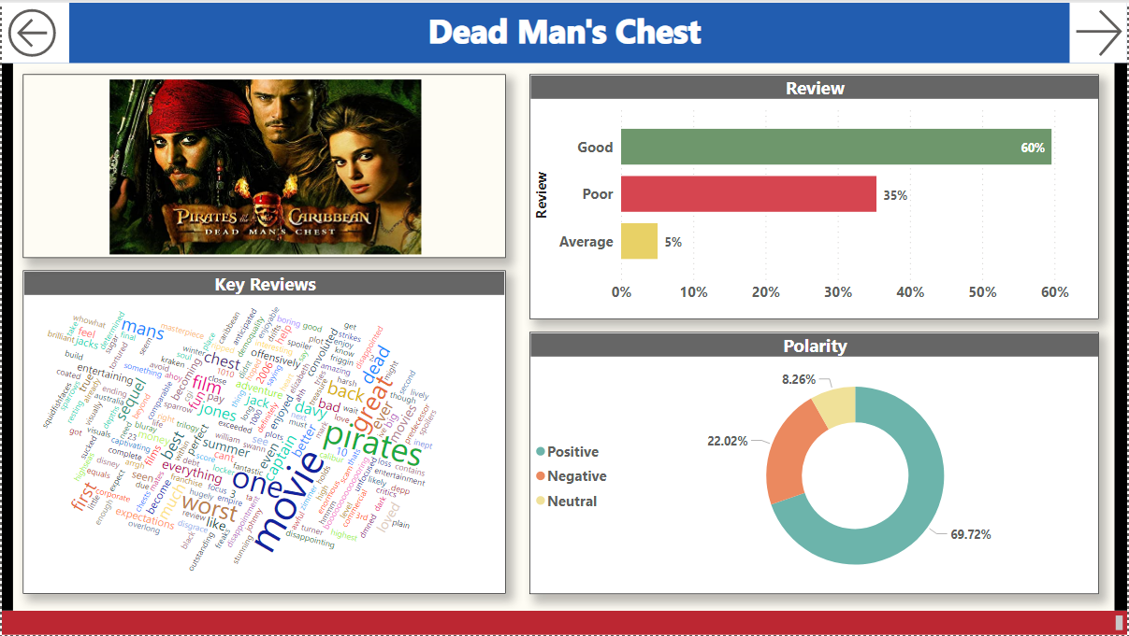
Dashboard 2 – Dead Man’s Chest

Slide 14
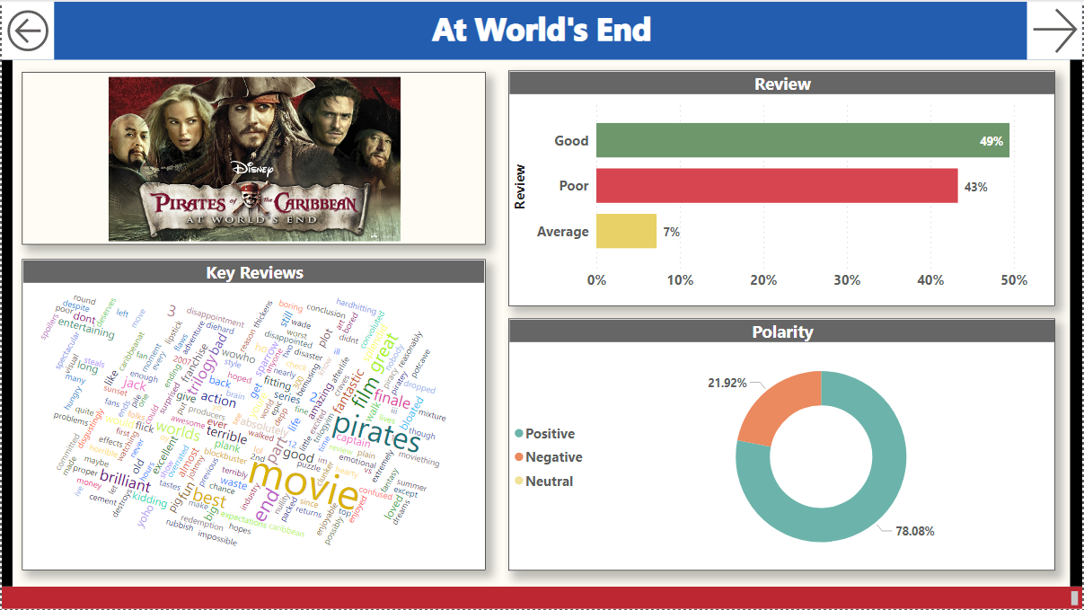
Dashboard 3 – At World’s End

Slide 15
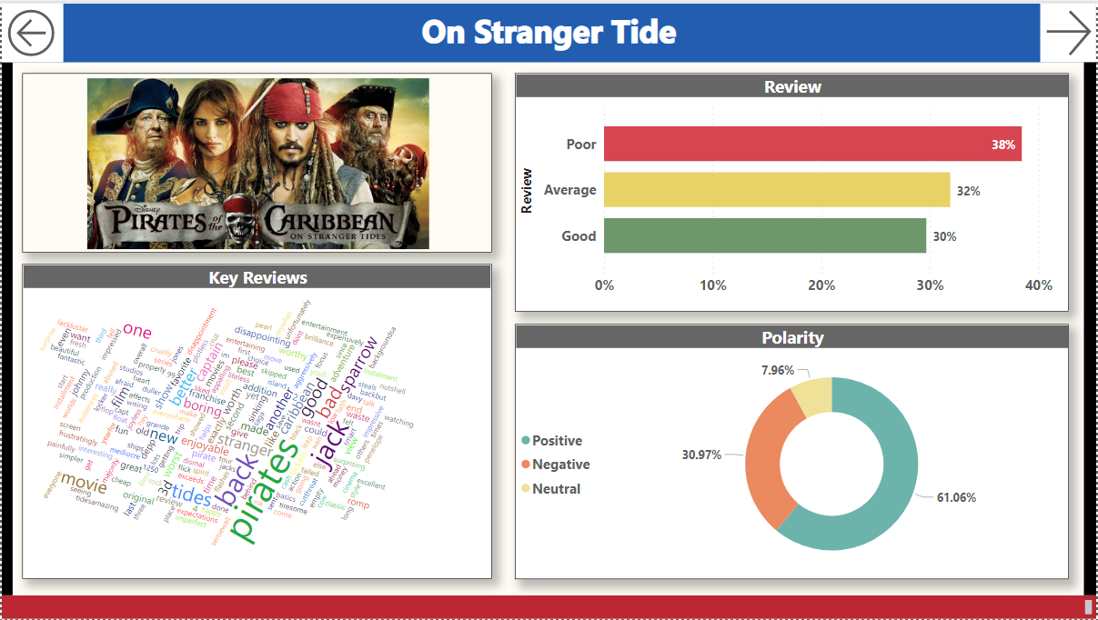
Dashboard 4 – On Stranger Tide

Slide 16
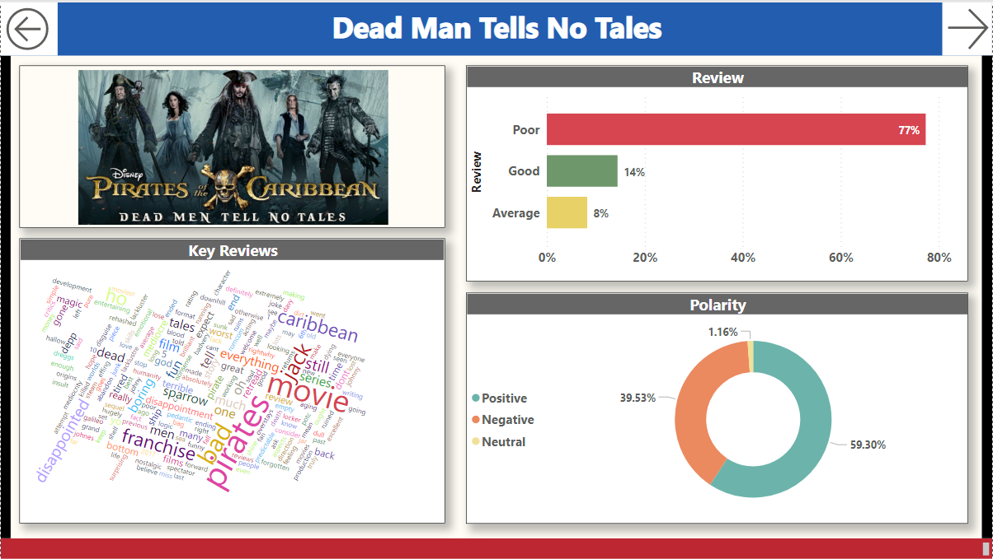
Dashboard 5 - Dead Man Tell No Tales

Slide 17
Video Link
https://www.youtube.com/watch?v=JZJY16NojUc

Slide 18
